Slide 1
Health-care System

Slide 2
Supervisor
by

Slide 3
Dr / Aref eliwa

Slide 4
MERNA FAYEZ

Slide 5
Covid-19
2020
North America
127M
Europe
249M
Asia
218M
South America
69M
Africa
Australia
14 M
12 M

Slide 6
IDEAS & SURVEY
Need for nursing

Slide 7
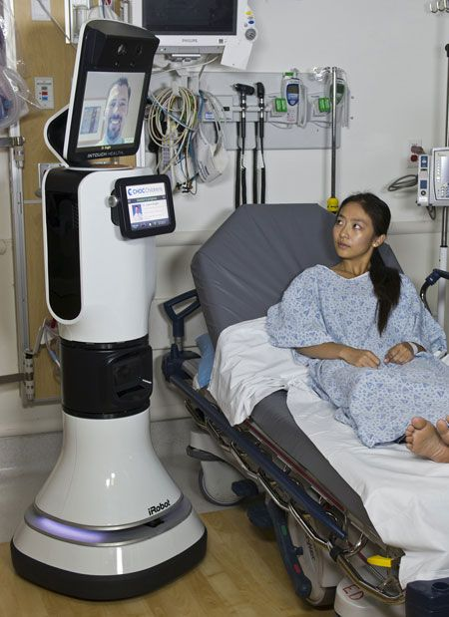
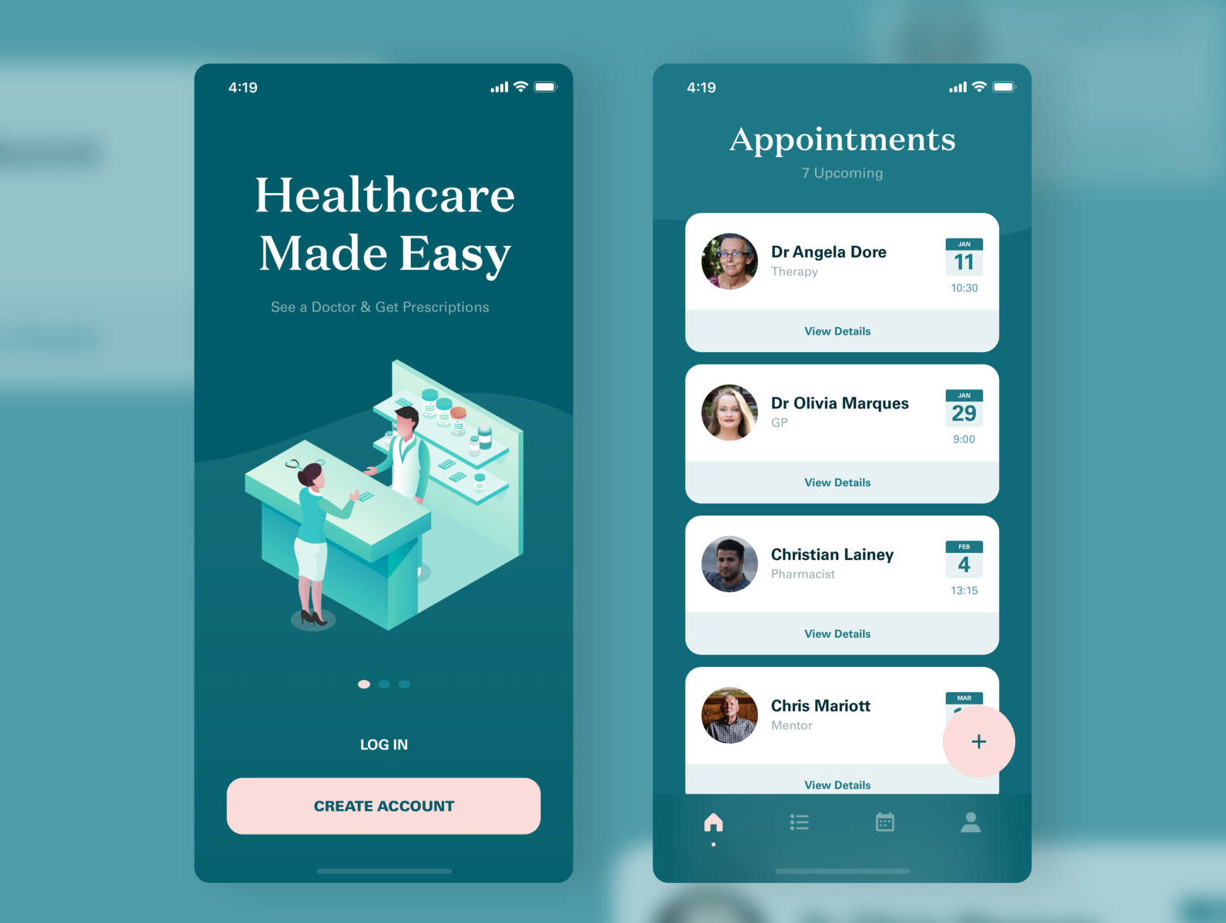
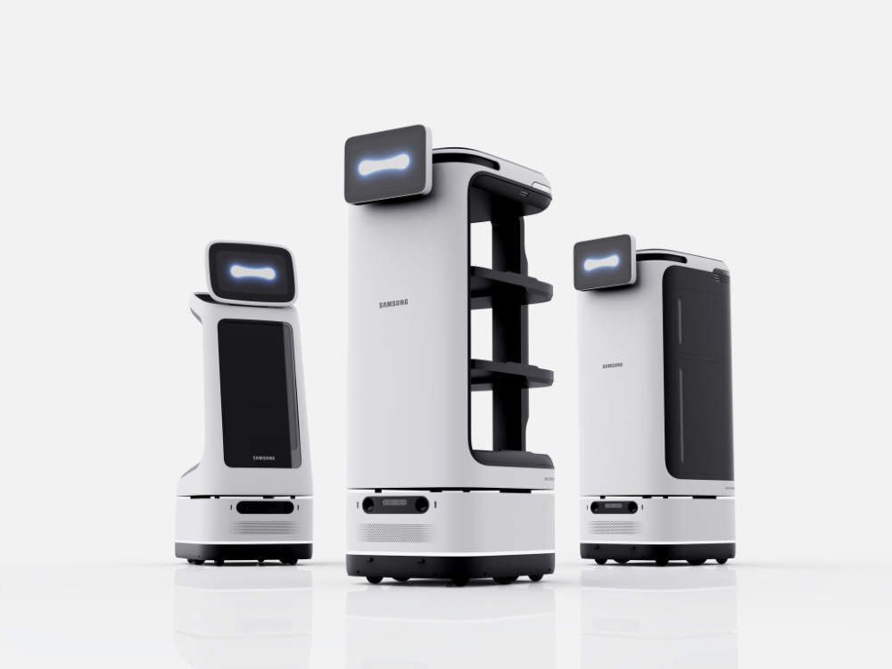
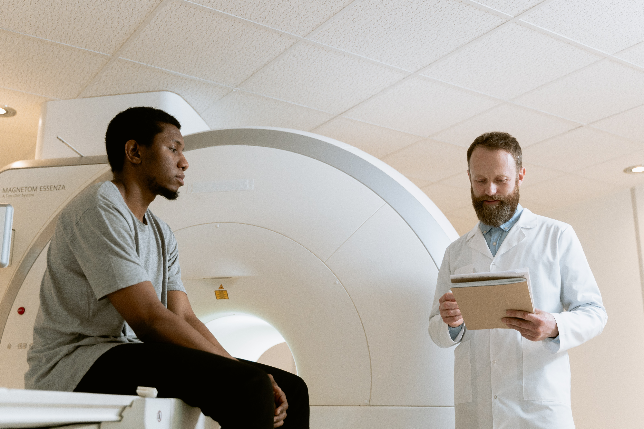

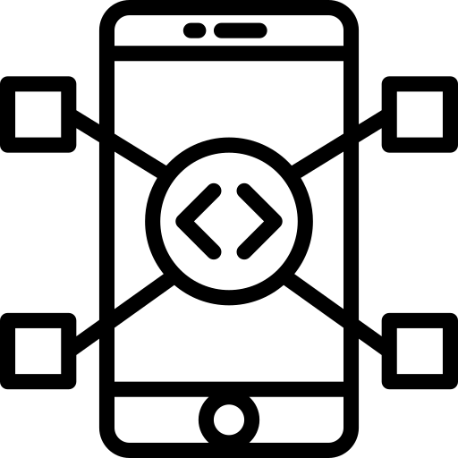


IDEAS & SURVEY

Slide 8
IDEAS & SURVEY

Slide 9
IDEAS & SURVEY

Slide 10
IDEAS & SURVEY

Slide 11
IDEAS & SURVEY

Slide 12
FEATURES
Complete
Cost
Implement
Easy

Slide 13
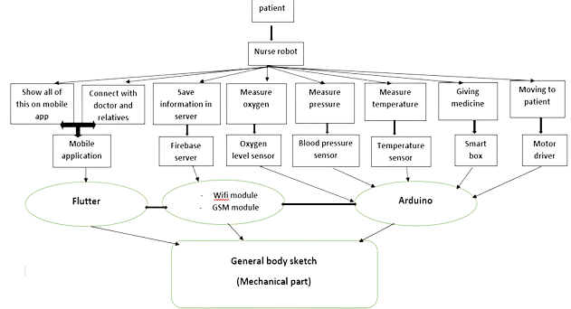
Flowchart Of All Project

Slide 14
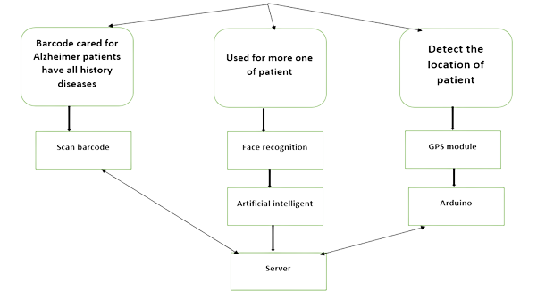
Flowchart of future plan
activity | Assigned to | start date | end date
search for an idea | All team | 05/09/2022 | 30/06/2023
body sketch (Survey, chapter in book, simulation, test) | Mohamed Magdy Abdulrahman tymor | 30/10/2022 | 04/05/2023
robot moving sensors work (Survey, chapter in book, simulation, test) | Ibrahim Alaa Tarek Adel | 10/11/2022 | 15/03/2023
box of medicine (Survey, chapter in book, simulation, test) | Raneem Mosad Fatma Ali | 15/12/2022 | 22/02/2023
mobile app (Survey, chapter in book, simulation, test) | Karim Mahmoud Heba Tallah Hatem | 30/11/2022 | 20/03/2023
communication (Survey, chapter in book, simulation, test) | Ahmed Awad Merna Fayez | 15/12/2022 | 22/04/2023

Slide 15
Gantt Chart
activity | Assigned to | start date | end date
search for an idea | All team | 05/09/2022 | 30/06/2023
body sketch (Survey, chapter in book, simulation, test) | Mohamed Magdy Abdulrahman tymor | 30/10/2022 | 04/05/2023
robot moving sensors work (Survey, chapter in book, simulation, test) | Ibrahim Alaa Tarek Adel | 10/11/2022 | 15/03/2023
box of medicine (Survey, chapter in book, simulation, test) | Raneem Mosad Fatma Ali | 15/12/2022 | 22/02/2023
mobile app (Survey, chapter in book, simulation, test) | Karim Mahmoud Heba Tallah Hatem | 30/11/2022 | 20/03/2023
communication (Survey, chapter in book, simulation, test) | Ahmed Awad Merna Fayez | 15/12/2022 | 22/04/2023

Slide 16
MOHAMMED MAGDY

Slide 17

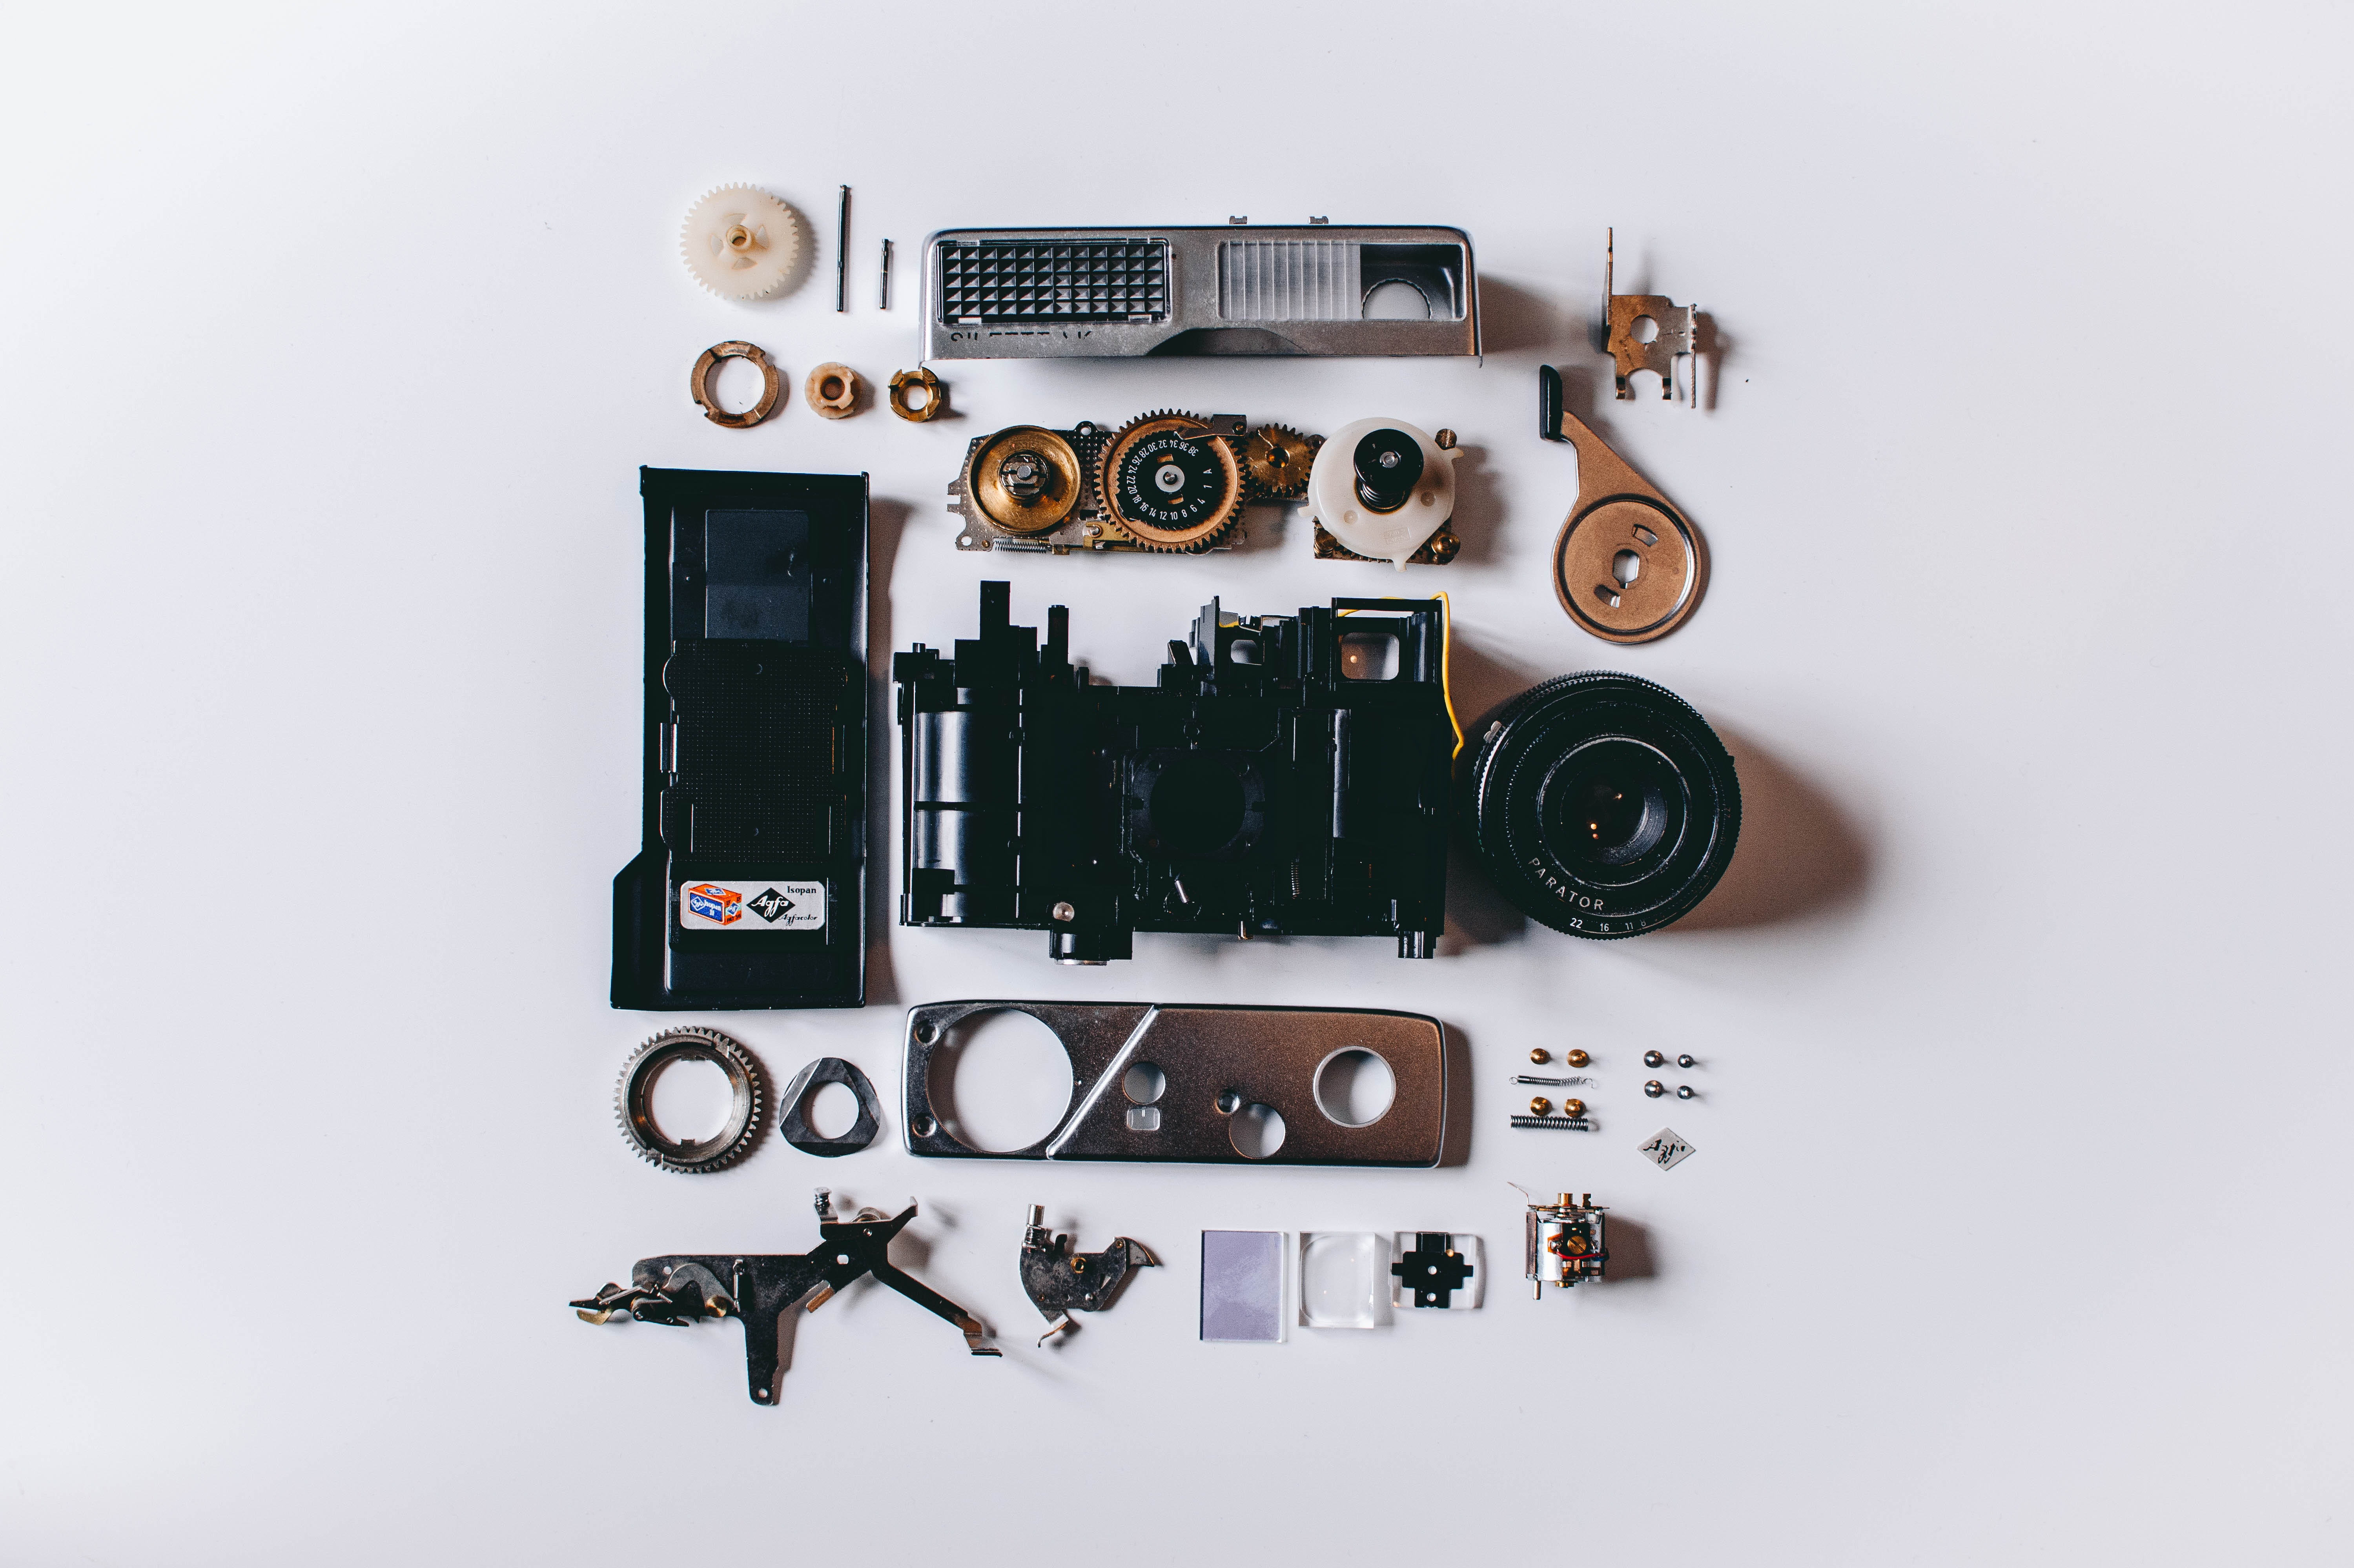

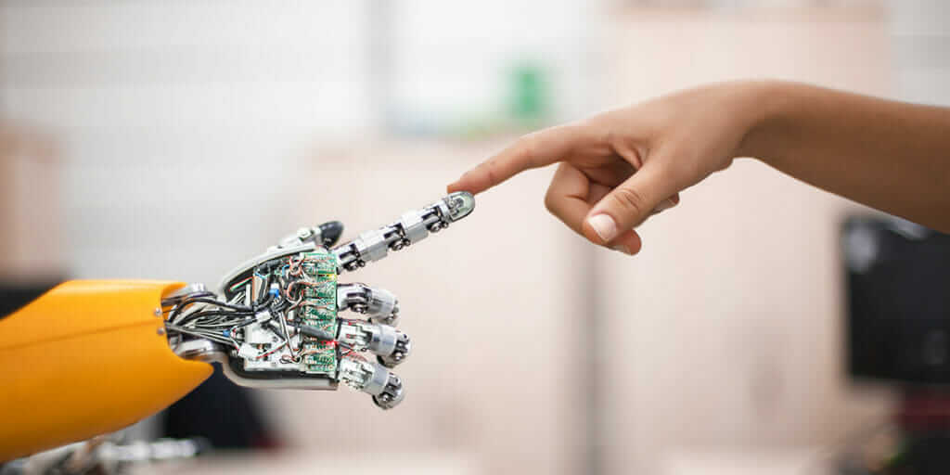
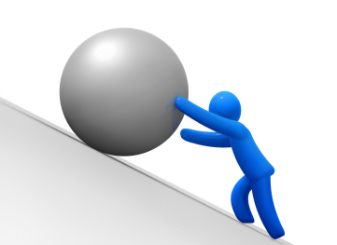
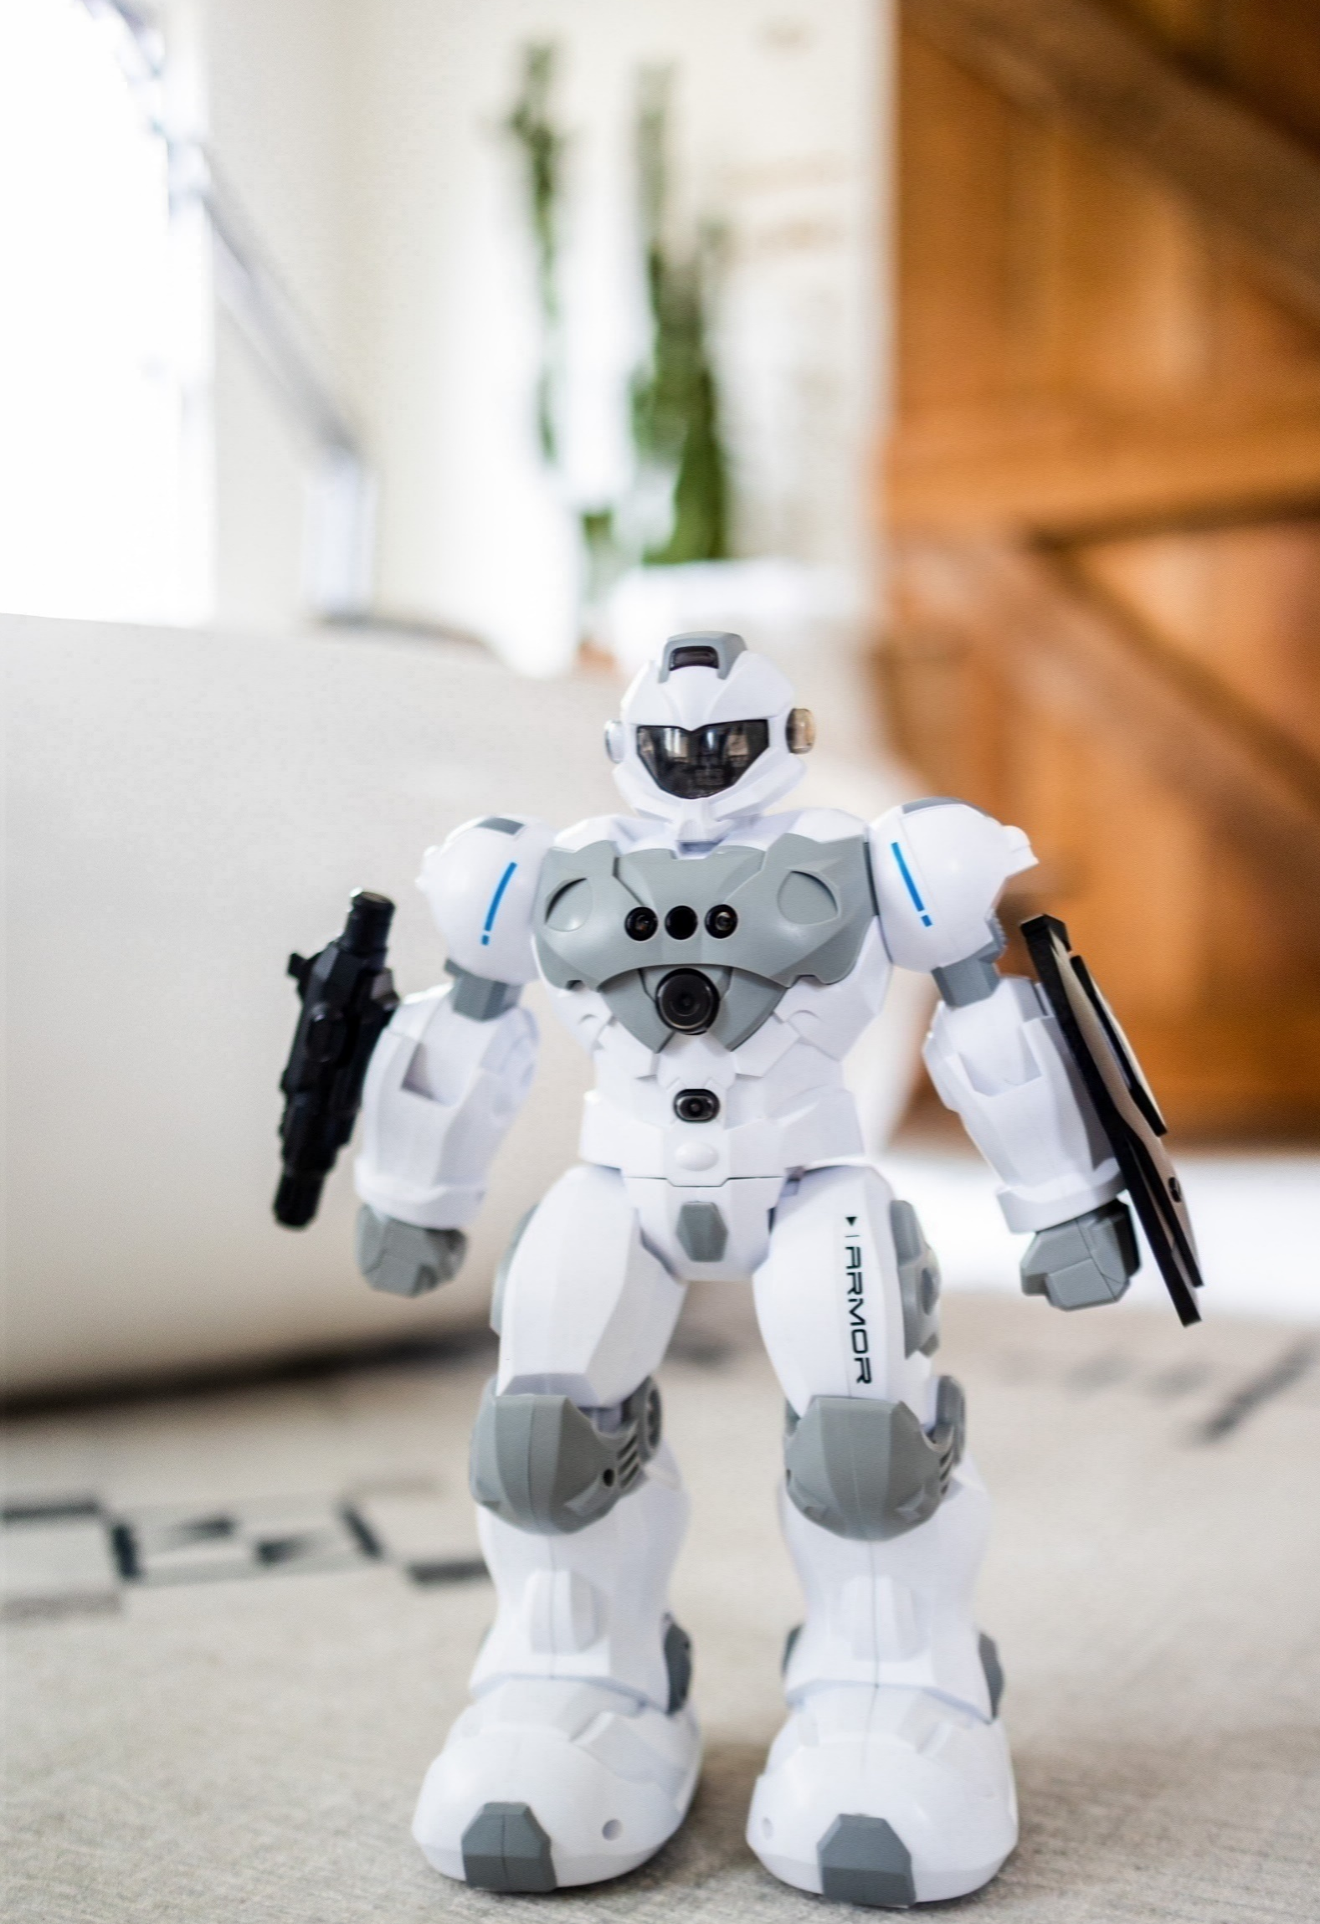

CONTENTS

Slide 18
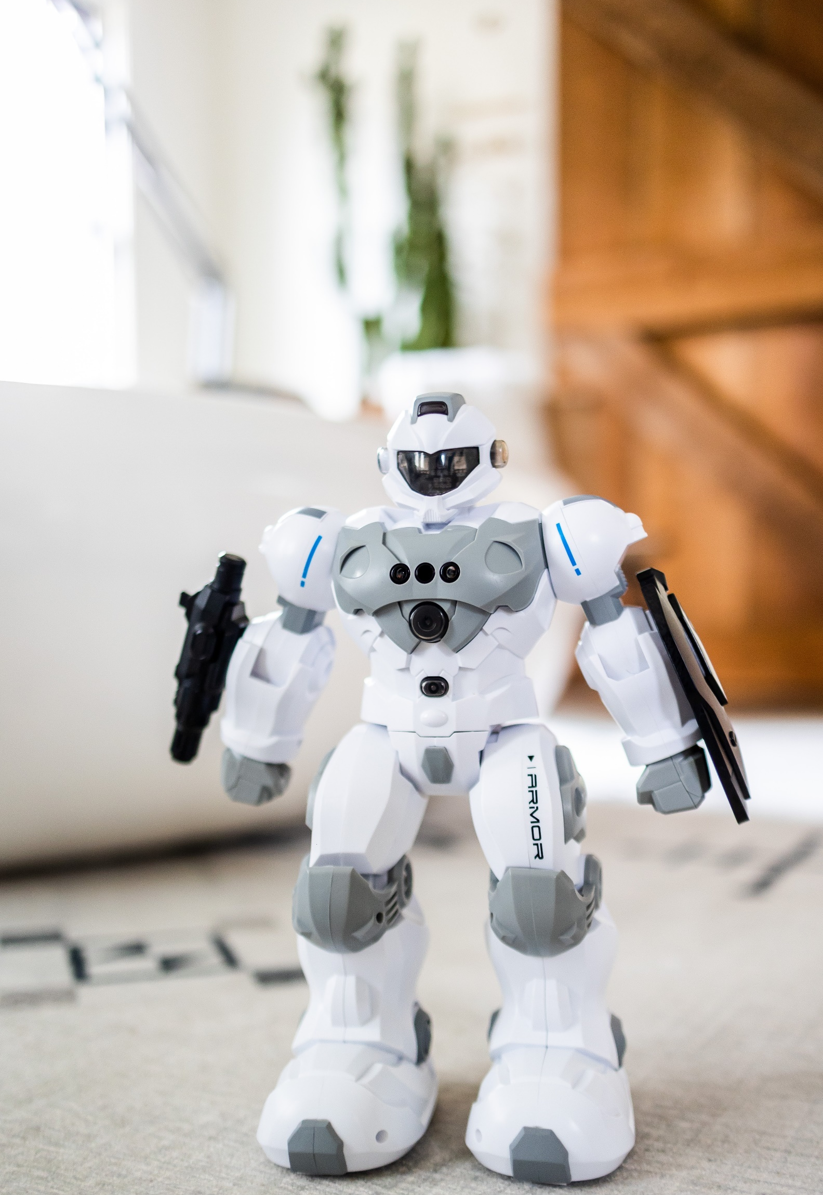
PREVIOUS DESIGNS
CONTENTS
MAIN GOALS

Slide 19
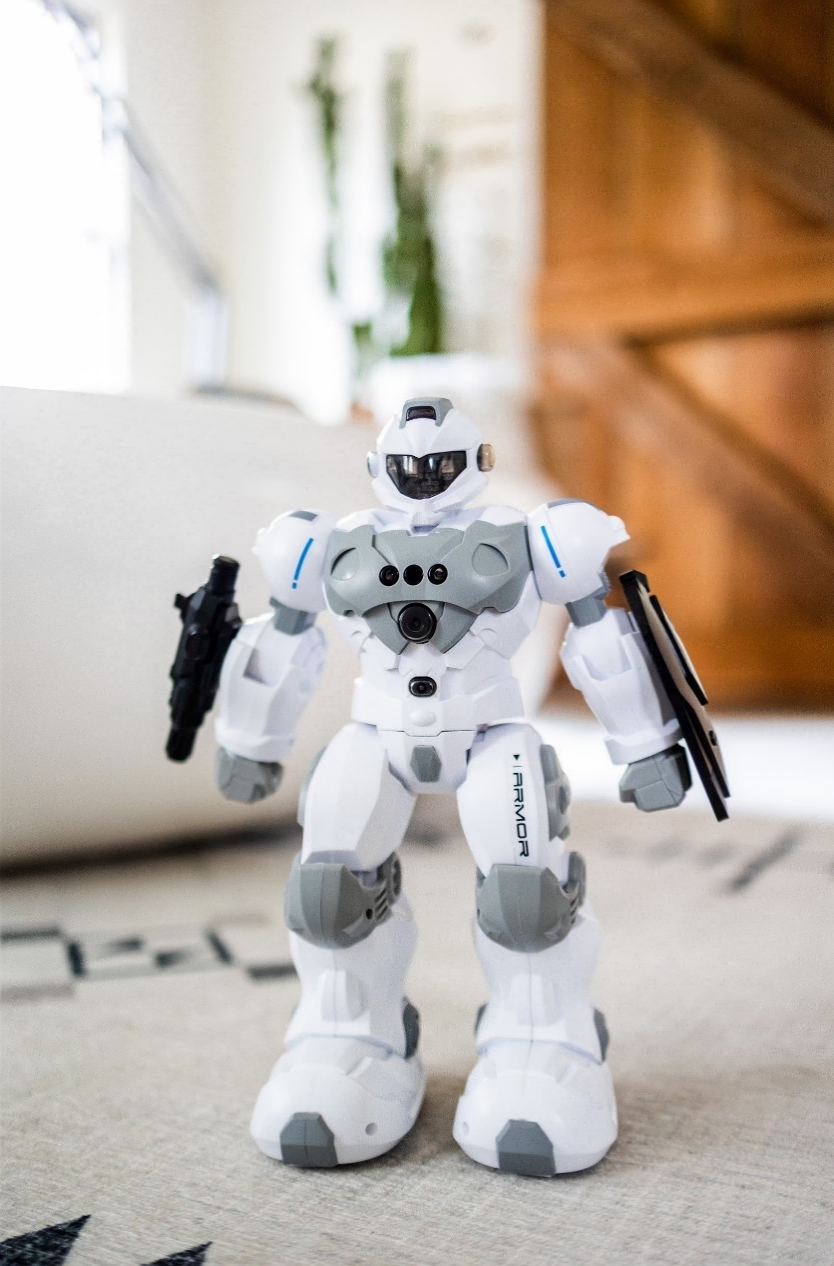
PREVIOUS DESIGNS
MAIN GOALS
CONTENTS
CHALLENGES

Slide 20
MAIN GOALS
CHALLENGES
CONTENTS
USED TECHNOLOGY

Slide 21
CHALLENGES
USED TECHNOLOGY
CONTENTS
RESULT

Slide 22
USED TECHNOLOGY
RESULT
CONTENTS
ROBOT PARTS

Slide 23
RESULT
ROBOT PARTS
CONTENTS
FUTURE PLAN

Slide 24

ROBOT PARTS
FUTURE PLAN
CONTENTS

Slide 25
CONTENTS

Slide 26
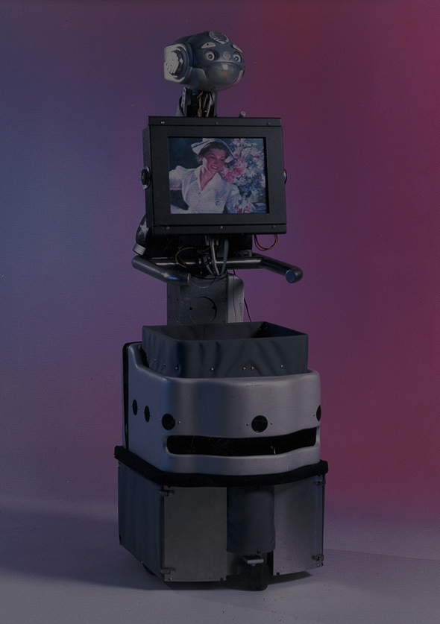
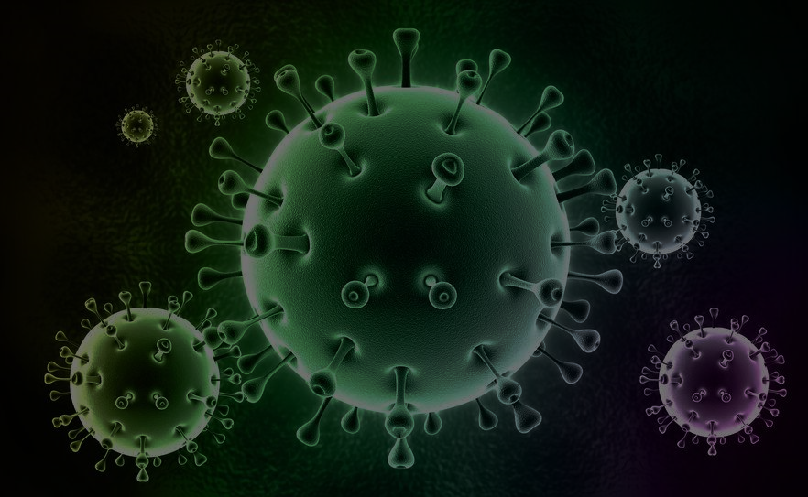
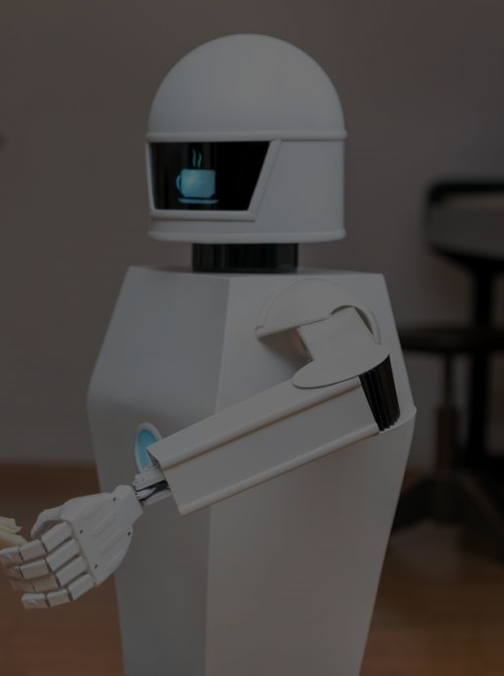
Main Goals
Reduce Nurse Workloads

Slide 27
Main Goals
Intrinsic Immunity To The Virus.

Slide 28
Main Goals
Improve User Acceptability Of Social Robots

Slide 29
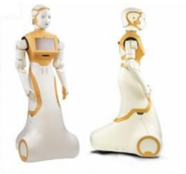
Previous Designs

Slide 30
Improve User Acceptability Of Social Robots
CONSIST
Face
Eyes
Monitor
Voice
Arm

Slide 31
Challenges
1- Mobility
4- Simplicity
2- light Wightless
5- COST
3- modernity
6- Security

Slide 32

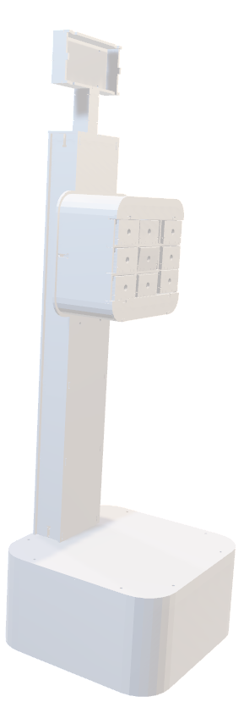
Software Used (Solid Works)

Slide 33
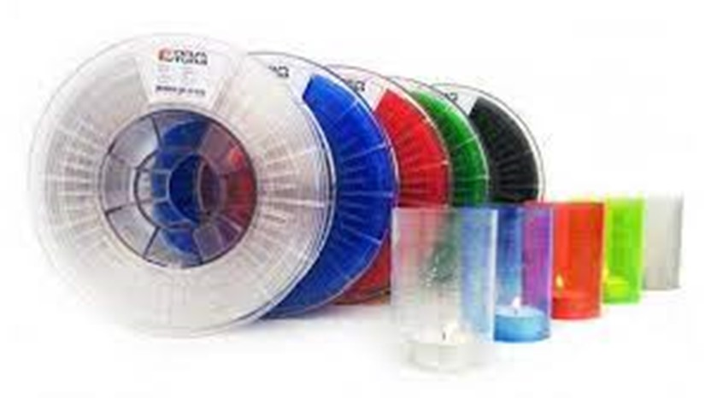
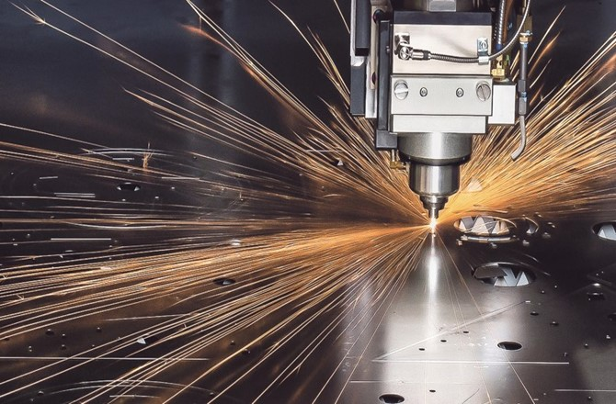
High Quality
light Weightless
Lazer cut
Acrylic Material

Slide 34
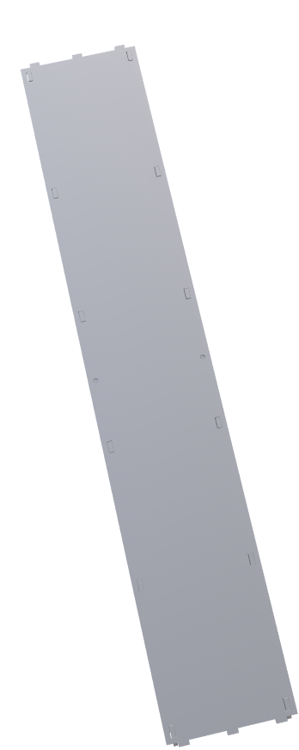
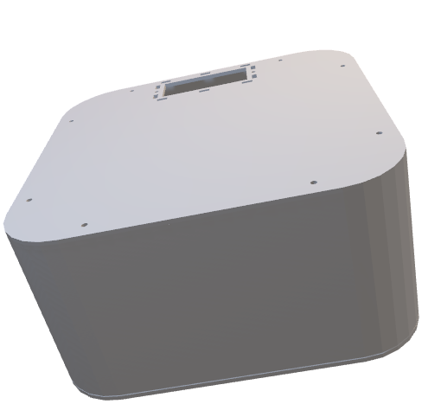
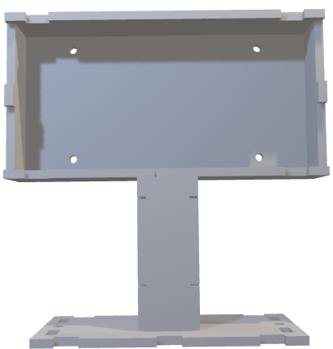
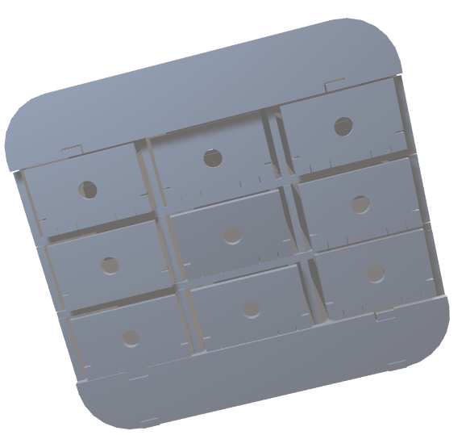
Mobility

Slide 35
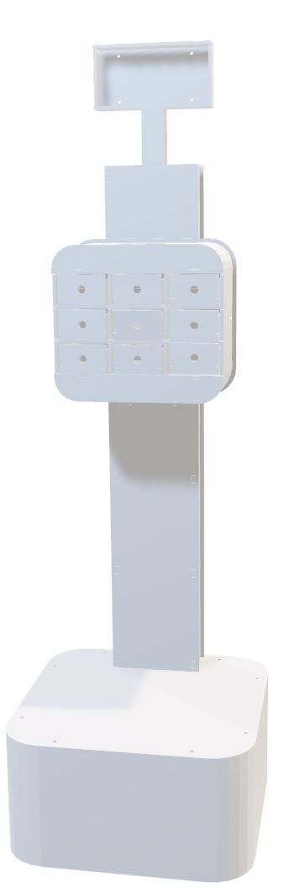
Marta One

Slide 36
ABDELRAHMAN TYMOR

Slide 37

Robot Parts

Slide 38
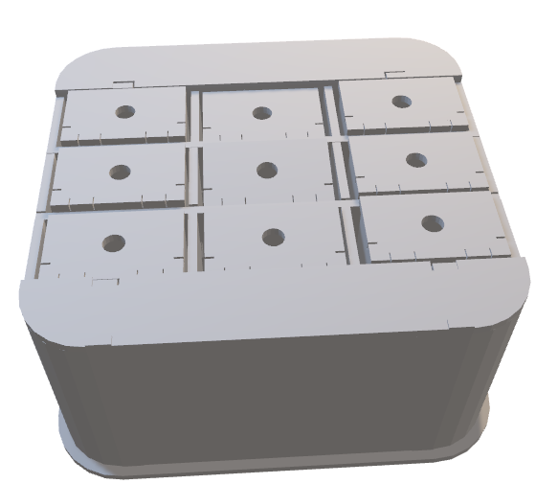
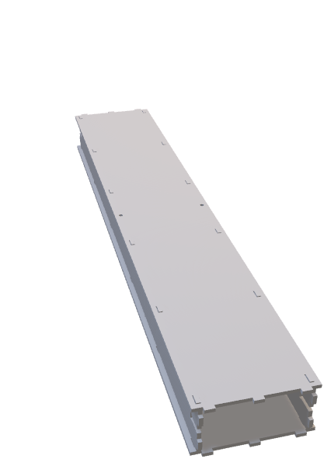
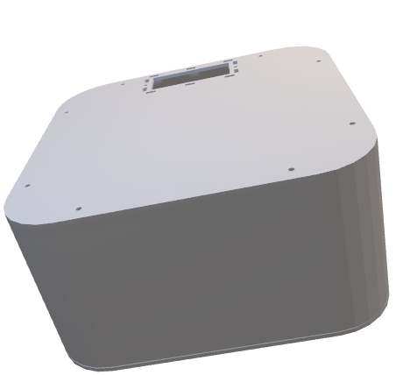
Robot Parts
Monitoring
Boxes
Base
Stick

Slide 39

Monitoring

Slide 40
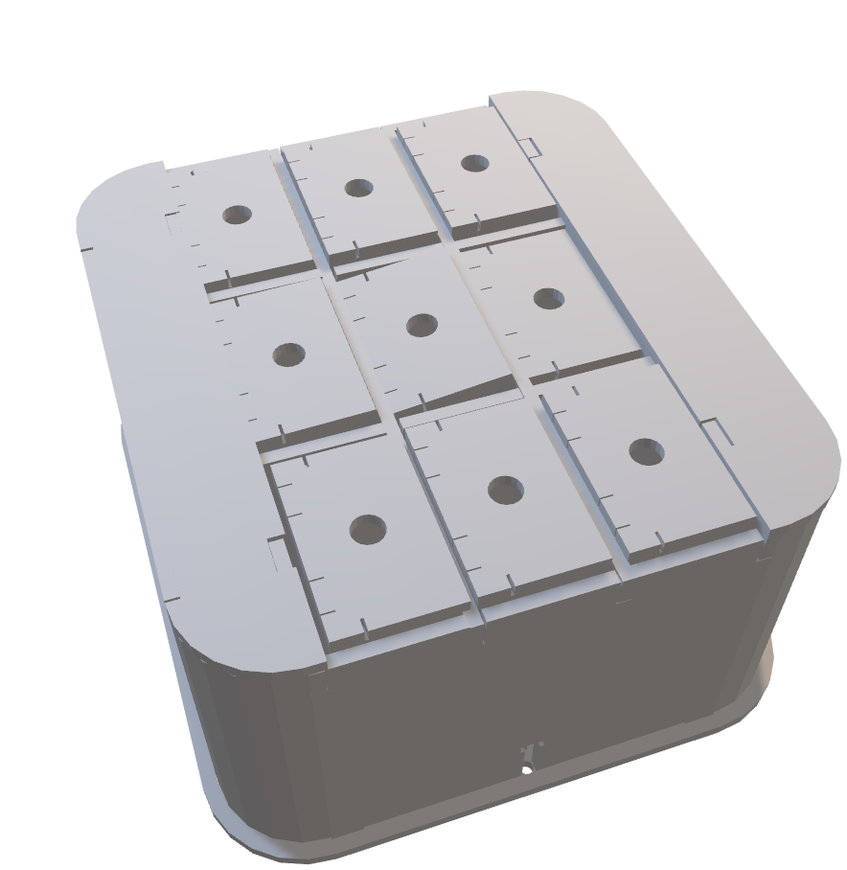
Boxes

Slide 41
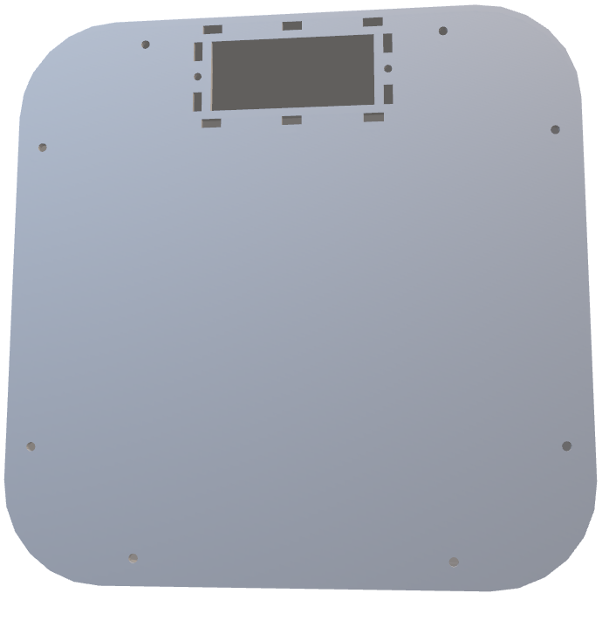
Base

Slide 42
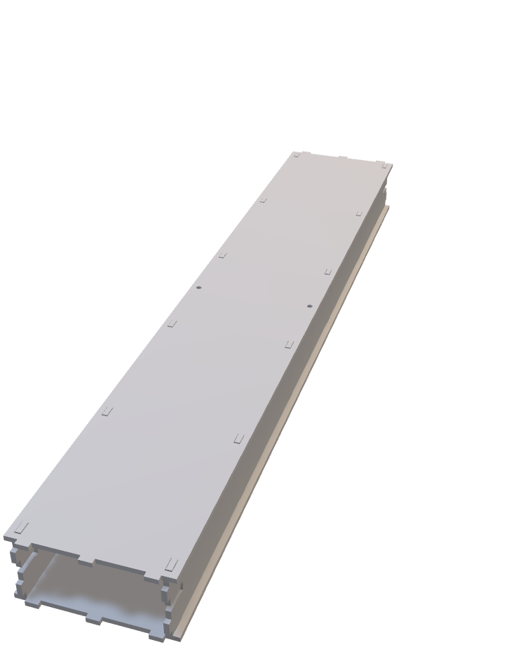
Stick

Slide 43

TAREK ADEL

Slide 44
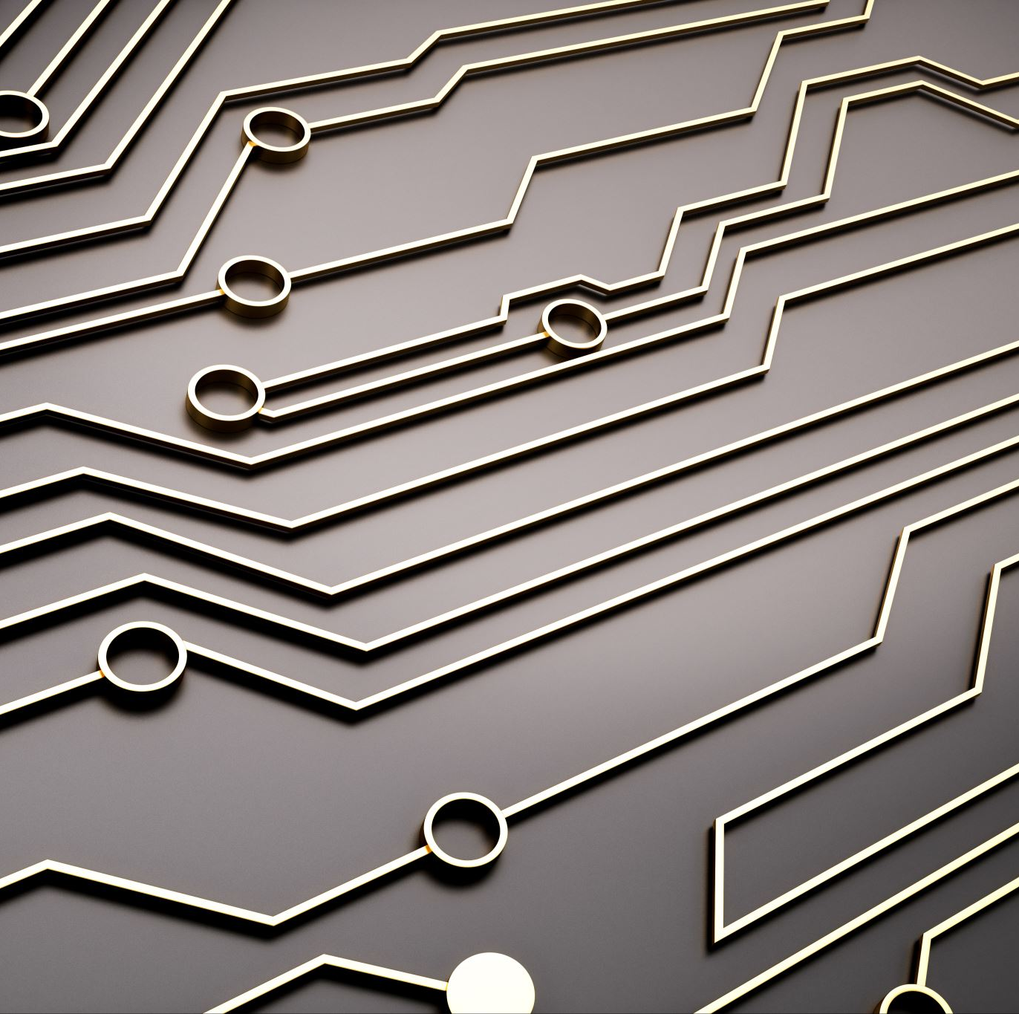
Hardware

Slide 45
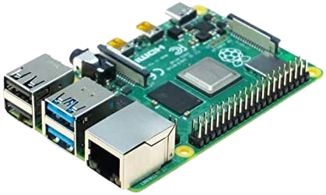
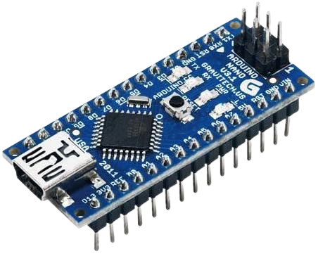
Problems
Interactors
Real Time (RTC)
Sensors
COST
Motion
Microcontrollers
Communication Protocols
CONNECTION
Combination

Slide 46
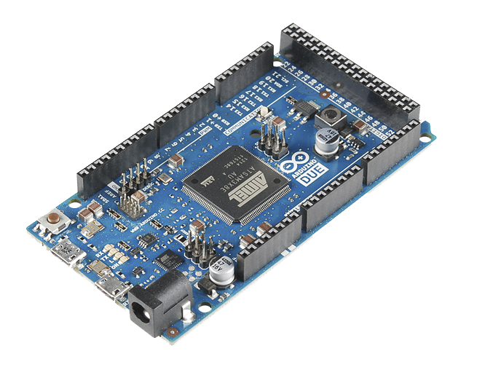
ARDUINO MEGA
Interactors
LCD (4*20)
Buzzer
LED

Slide 47
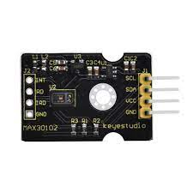
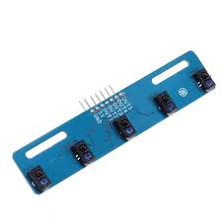
Sensors

Slide 48
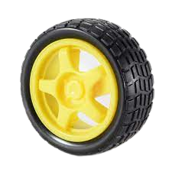
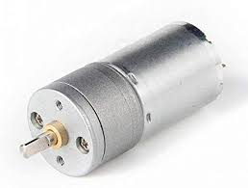
Motion

Slide 49
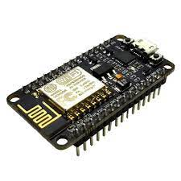
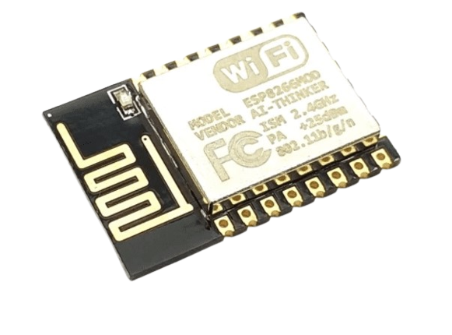
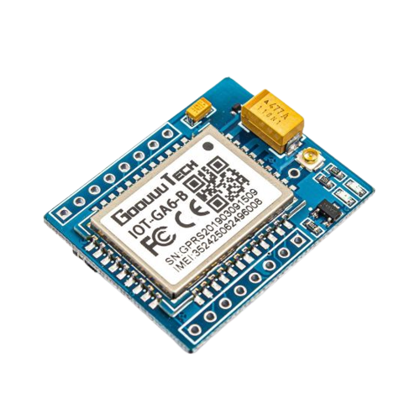
SHOWING
Microcontrollers
LEDS

Slide 50
SHOWING
Communication Protocols
I2c MAX & RTC to Mega
UART Mega & Nodemcu8266
LEDS

Slide 51
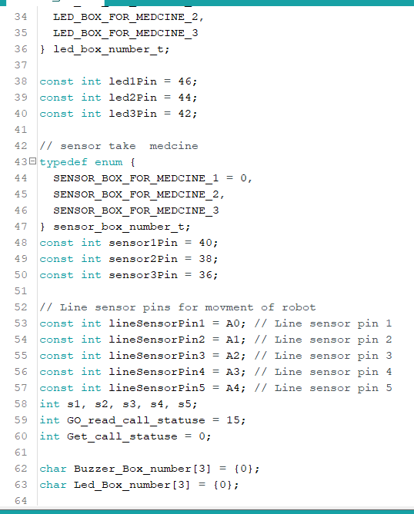
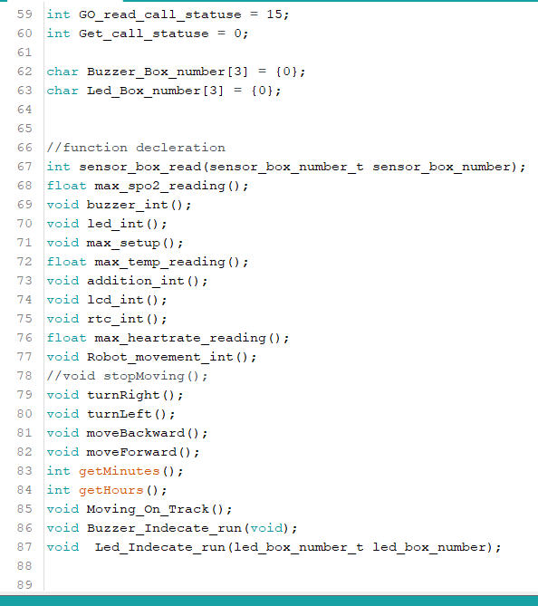
Combination

Slide 52
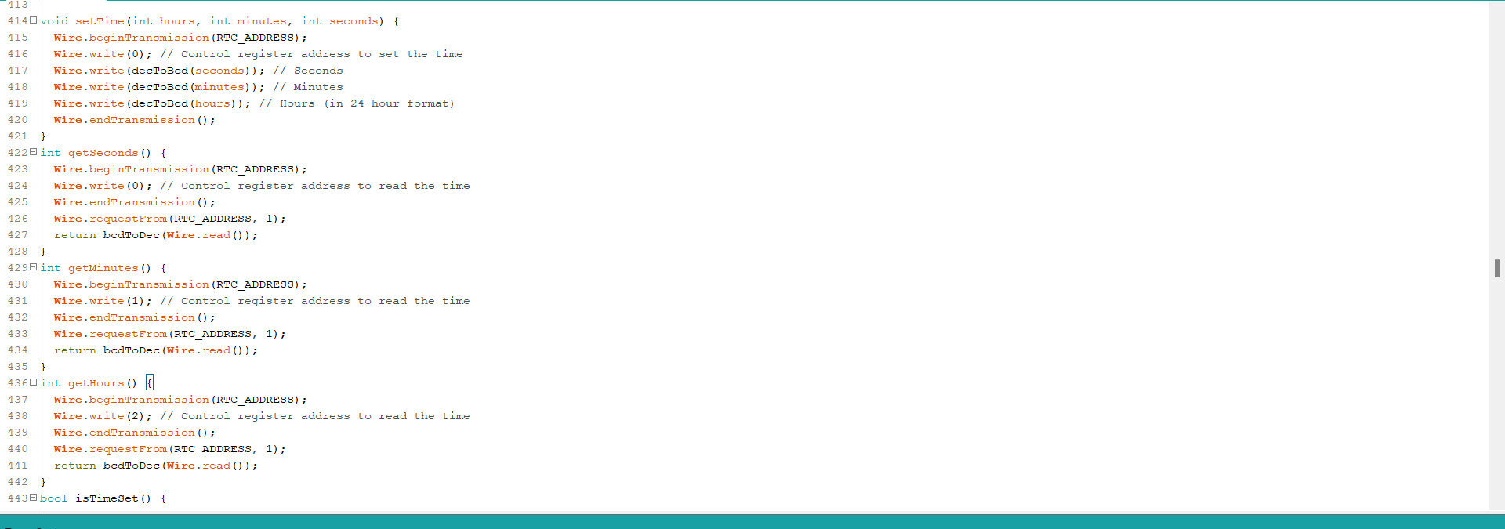
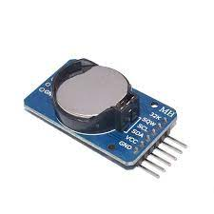
Real Time
RTC module

Slide 53

GitHub

Slide 54
RANEEM MOSAD

Slide 55
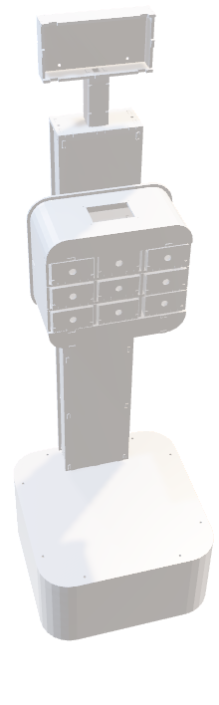
What Is Sensor ?
MEDICAL SENSORS
MLX90614 SENSOR
MAX30102 SENSOR

Slide 56
What Is Sensor ?
Sensors are devices that detect changes in physical phenomena and send the information to other electronics.
MLX90614 SENSOR
MAX30102 SENSOR
MEDICAL SENSORS

Slide 57
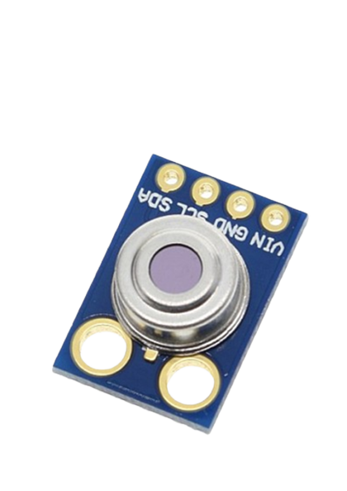
sense temperature(Main)
Accuracy: ±0.5°C
Resolution: ±0.2°C
Distance between object and sensor: 2cm-5cm
MLX90614 SENSOR

Slide 58
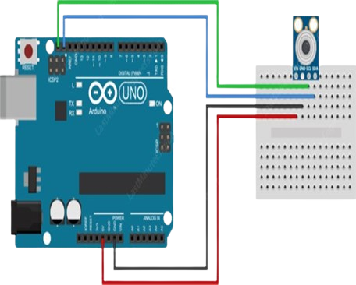
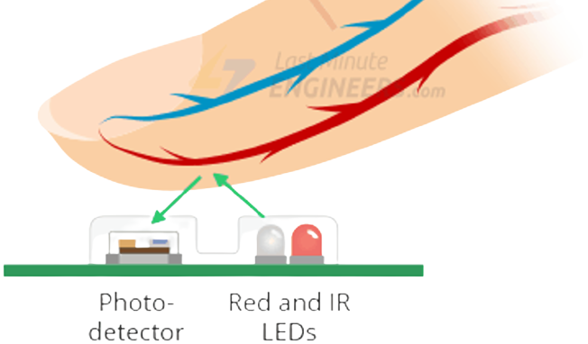


MLX90614 SENSOR
sense temperature (spare)
Accuracy: ±0.5°C
Resolution: ±0.2°C
Distance between object and sensor: 2cm-5cm

Slide 59
MLX90614 SENSOR
Circuit Diagram & Connection

Slide 60


MAX30102 SENSOR
SENSING
SPO2
Heart Rate
Reading Temperature (Main)

Slide 61
MAX30102 SENSOR
Circuit Diagram & Connection

Slide 62


MAX30102 SENSOR
Reading In Real - Life
SP02
Heartbeat

Slide 63
FATMA ALI

Slide 64
Medical Box

Slide 65




Slide 66


Medical Box
ROBOT
1. The robot reminds patients of medication appointments using LED, an illuminated medicine box and a buzzer.
MOTION

Slide 67

Medical Box
2. The motion of robot while carrying the medical box from its base to its destination (patient).
ROBOT
MOTION
3. The medicine box is divided into 3 sections for different medication schedules and the robot uses an IR sensor to indicate which section to open.
Heartbeat

Slide 68


Medical Box
4. IR SENSOR :
We using IR because its cheep and This box will be self open from patient.
ROBOT
MOTION

Slide 69
IBRAHIM ALAA

Slide 70
ROBOT
MOTION

Slide 71

ROBOT
MOTION
MECHANICAL
ELECTRICAL
SOFTWARE

Slide 72

MECHANICAL
4 DC MOTORS
Operating voltage: between 6 V and 18 V Nominal voltage: 12 V Free-run speed at 12 V: 133 RPM Free-run current at 12 V: 50 mA Stall current at 12 V: 1200 mA Stall torque at 12 V: 20 kg.cm Gear ratio: 1:78 Reductor size: 21 mm

Slide 73
MECHANICAL
WHEELS
1. Rubber
2. Light

Slide 74
ROBOT
MOTION
MECHANICAL
ELECTRICAL
SOFTWARE

Slide 75

ELECTRICAL
MOTOR DRIVER
Supply voltage: 12V Maximum output current: 2A per channel Module to control two DC motors or one stepper motor The system has a mounted radiator and tile size: 43.5 x 43.5 x 29 mm.

Slide 76

ELECTRICAL
LINE FOLLOWER SENSOR
Sensor Black and White 5 channel line follower sensor with TCRT5000

Slide 77



Slide 78
ROBOT
MOTION
MECHANICAL
ELECTRICAL
SOFTWARE

Slide 79
Heba Tallah Hatem

Slide 80
SOFTWARE

Slide 81
Healthcare Mobile App
Goals of Our Mobile App
1-Ease of movement for the patient.
2-Provide some measurements such as measuring ( temperature, heartbeat, oxygen saturation in blood ).
3-Provide medication schedule.
4-Accessible measurements at any time.

Slide 82



Healthcare Mobile App
Design Stages
1-Design of user interface by Figma.
2-Implementation of app design by Flutter and Dart.

Slide 83
Healthcare Mobile App
Flutter
What is flutter?
It is a platform that released by Google in May 2017.
Advantages And Properties:
Free to use
Uses Drat programming language with (OOP)
Easy to learn
Has a lot of widgets

Slide 84
Healthcare Mobile App
Dart
What is the Dart language?
Released by Google in October 2011.
Advantages And Properties:
Dart is a client-optimized language for developing fast apps on any platform.
Open Source
Free to Use
Used to customize Flutter widgets.

Slide 85

Healthcare Mobile App
Flow Chart of Mobile Application

Slide 86

Healthcare Mobile App
Container(
image:AssetImage('asset/ogin.png'),
child: Center(
child: Column(
children:[
Text('Welcome to Healthcare Monitoring System'),
ElevatedButton(
child: Text('Sign up')
),
]
),
),
),

Slide 87

Healthcare Mobile App
var name , email , password , age ;
final _nameController=TextEditingController();
final _ageController=TextEditingController();
final _emailController=TextEditingController();
final _passwordController=TextEditingController();
final _confirmpasswordController=TextEditingController();
Future signUp() async{
if (passwordConfirmed()) {
UserCredential credential=await
FirebaseAuth.instance.createUserWithEmailAndPassword(
email: _emailController.text.trim(),
password: _passwordController.text.trim(),
);
),

Slide 88
Healthcare Mobile App
UserID.UID=credential.user?.uid;
UserID.email=_emailController.text.trim();
UserID.name=_nameController.text.trim();
UserID.age=_ageController.text.trim();
await UserID.setUserData();
// ignore: use_build_context_synchronously
Navigator.push(
context,
MaterialPageRoute(builder: (context) => const MyApp()),
);
}
}

Slide 89
Healthcare Mobile App
Column(
children:[
TextFormField(
onSaved: (val){
email= val;
},
validator: (val) {
if (val!.length > 100) {
return "Email can not be larger than 100 letters";
}
if (val.length < 2) {
return "Email can not be less than 2 letters";
}
return null;
},
controller: _emailController,
), ElevatedButton(
onPressed: signUp,
child: const Text('Sign up'),
),
]

Slide 90

Healthcare Mobile App
final _emailController=TextEditingController();
final _passwordController=TextEditingController();
Future signIn() async{
UserCredential credential=await FirebaseAuth.instance.signInWithEmailAndPassword(
email: _emailController.text.trim(),
password: _passwordController.text.trim(),
);
UserID.UID=credential.user?.uid;
await UserID.getUserData();
// ignore: use_build_context_synchronously
Navigator.push(
context,
MaterialPageRoute(builder: (context) => const MyApp()),
);
}
Column(
TextField(
controller: _emailController,
),
ElevatedButton(
onPressed: () async{
await signIn();
},
child: const Text('Sign in'),
),
),

Slide 91
x

Slide 92
Ahmed Awad

Slide 93

IOT

Slide 94
IOT PROTOCOLS
WIFI
GSM
BLUETOOTH
NFC
ZIG BEE

Slide 95



GSM & WIFI

Slide 96

WIFI MODULE

Slide 97
WIFI MODULE
TWO PHASES WITH ARDUINO :
1- Programming Phase.
2- Working Phase.

Slide 98

GSM MODULE

Slide 99

GSM MODULE
GSM WITH ARDUINO :

Slide 100
HEALTH-CARE
SYSTEM

Slide 101
HEALTH-CARE
SYSTEM
Thanks for listening

